Slide 1
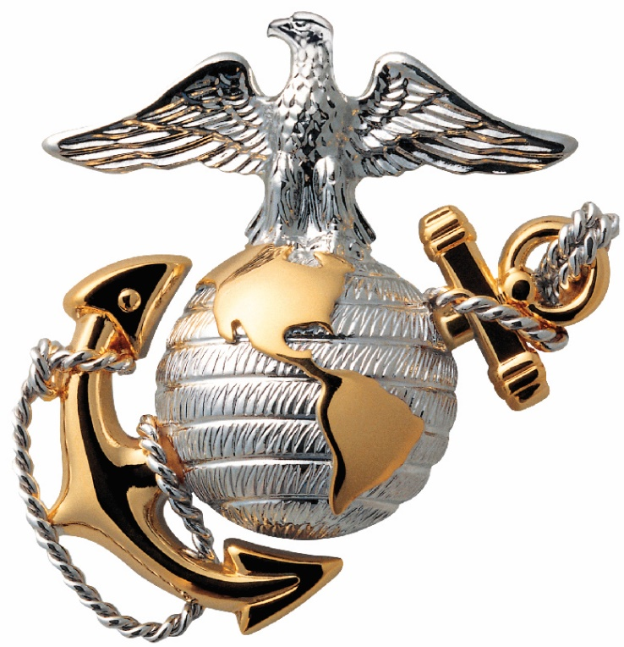
Marines’ Hymn
Event
Title
From the halls of Montezuma
To the shores of Tripoli
We fight our country’s battles
In the air, on land and sea.
First to fight for right and freedom,
And to keep our honor clean,
We are proud to claim the title of
UNITED STATES MARINE.
Our Flag’s unfurl’d to every breeze
From dawn to setting sun;
We have fought in every clime and place
Where we could take a gun.
In the snow of far-off northern lands
And in sunny tropic scenes,
You will find us always on the job, the
UNITED STATES MARINES.
Here’s health to you and to our Corps
Which we are proud to serve;
In many a strife we’ve fought for life
And never lost our nerve.
If the Army and the Navy
Ever look on Heaven’s scenes,
They will find the streets are guarded by
UNITED STATES MARINES.
XX Month Year
Quantico, VA

Slide 2
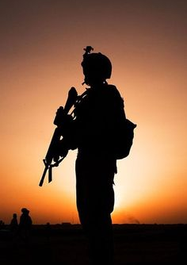
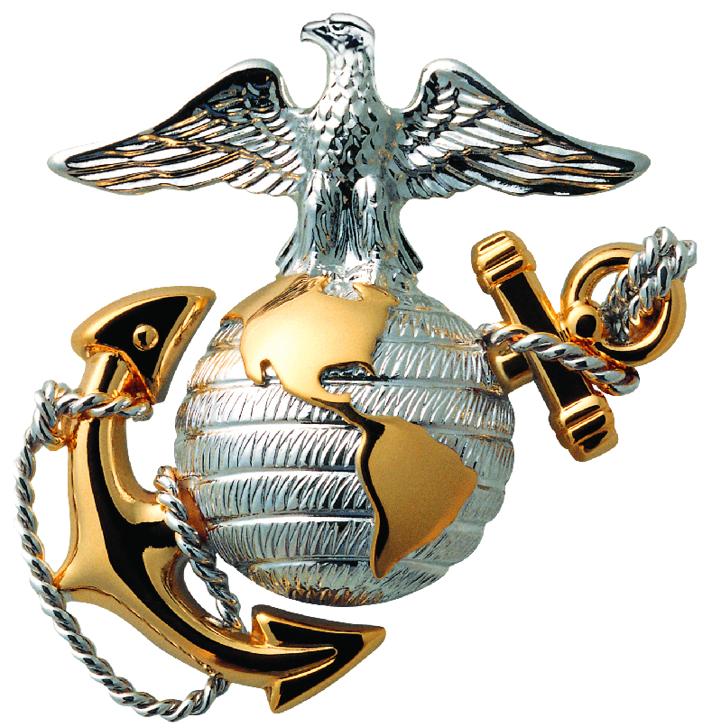
Sequence of Events
“The Watch”
Invocation
Adjutant’s call
Receive the report
Publish the order
National anthem
Reading of Certificates
Remarks
Anchors Away/ Marines Hymn
Conclusion of Retirement Ceremony
For xx years
This Marine has stood the watch
While some of us were in our bunks at night
This Marine stood the watch
While some of us were in school learning our trade and yes,
Even before some of us were born
This Marine stood the watch
In those years when the storm clouds of war were seen
Churning on the horizon of history
This Marine stood the watch
Many times he would cast an eye ashore and see his family
Standing there needing his guidance and help
Needing that hand to hold during those hard times
But he still stood the watch
He stood the watch so that we, our families, and our fellow
Countrymen, could sleep soundly in safety each and every
Night knowing a Marine stood the watch
Today we are here to say “Marine…the watch stands relieved.
Relieved by those you have trained, mentored, and led.”
Rank Name, you stand relieved.
We have the watch.

Slide 3
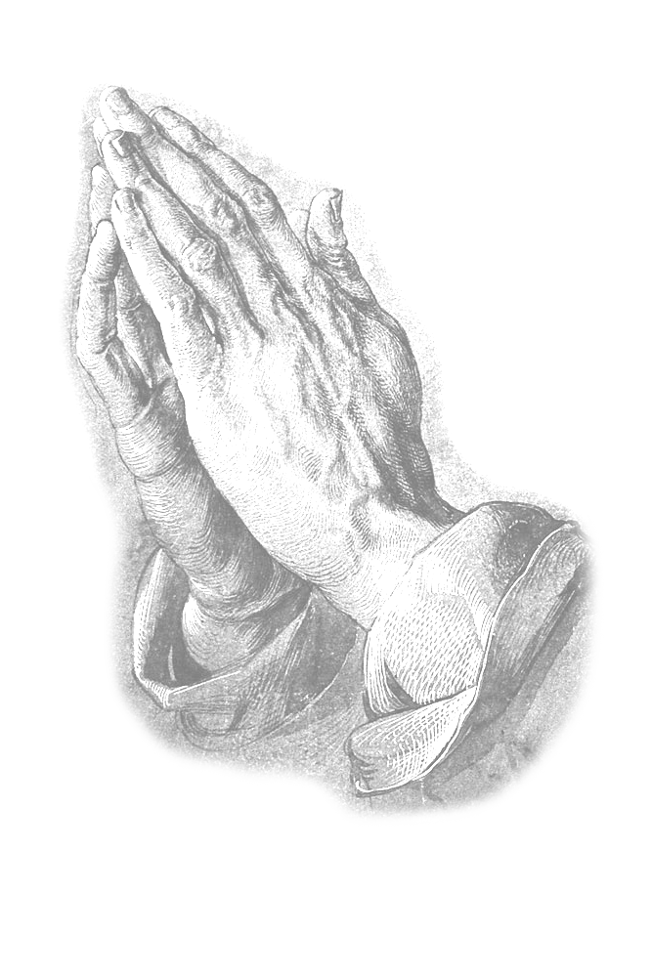
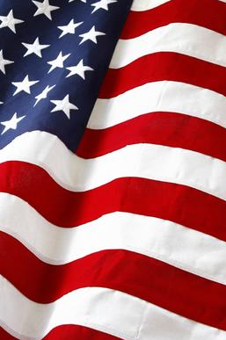
Marines’ Prayer
“Old Glory”
I am the flag
of the United States of America.
My name is Old Glory.
I fly atop the world's tallest buildings.
I stand watch in America's halls of justice.
I fly majestically over great institutes of learning.
I stand guard with the greatest military power in the world.
Look up! And see me!
I stand for peace - honor - truth and justice. I stand for freedom
I am confident - I am arrogant
I am proud.
When I am flown with my fellow banners
My head is a little higher; My colors a little truer.
I bow to no one. I am recognized all over the world.
I am worshipped - I am saluted - I am respected
I am revered - I am loved, and I am feared.
I have fought every battle of every war for more than 200 years:
Gettysburg, Shilo, Appomattox, San Juan Hill, the trenches of France,
the Argonne Forest, Anzio, Rome, the beaches of Normandy,
the deserts of Africa, the cane fields of the Philippines, the rice paddies and jungles of Guam,
Okinawa, Japan, Korea, Vietnam, Guadalcanal, New Britain, Peleliu, and many more islands.
And a score of places long forgotten by all but those who were with me.
I was there. I led my soldiers - I followed them. I watched over them.
They loved me. I was on a small hill in Iwo Jima.
I was dirty, battle-worn and tired, but my soldiers cheered me,
and I was proud.
I have been soiled, burned, torn and trampled on the streets of
countries I have helped set free. It does not hurt, for I am invincible.
I have been soiled, burned, torn and trampled on the streets of
my country, and when it is by those with whom I have served in battle - it hurts.
But I shall overcome - for I am strong. I have slipped the bonds of Earth
and stand watch over the uncharted new frontiers of space
from my vantage point on the moon.
I have been a silent witness to all of America's finest hours.
But my finest hour comes when I am torn into strips to
be used for bandages for my wounded comrades on the field of battle,
When I fly at half mast to honor my soldiers,
And when I lie in the trembling arms of a grieving
mother at the grave side of her fallen son.
I am proud.
My name is Old Glory .. long may I wave.
Dear God in Heaven .. long may I wave.
Almighty Father,
whose command is over all
and whose love never fails,
make me aware of Thy presence
and obedient to Thy will.
Keep me true to my best self,
guarding me against dishonesty in purpose and deed
and helping me to live so that I can face my fellow Marines,
my loved ones and Thee without shame or fear.
Protect my family.
Give me the will to do the work of a Marine
and to accept my share of responsibilities
with vigor and enthusiasm.
Grant me the courage to be proficient in my daily performance.
Keep me loyal and faithful to my superiors
and to the duties my country
and the Marine Corps have entrusted to me.
Make me considerate of those committed to my leadership.
Help me to wear my uniform with dignity, and let it remind me daily
of the traditions which I must uphold.
If I am inclined to doubt, steady my faith;
if I am tempted, make me strong to resist;
if I should miss the mark, give me courage to try again.
Guide me with the light of truth and grant me wisdom
by which I may understand the answer to my prayer.
Amen

Slide 4

Rank
First M. Last
United States Marine Corps
Rank
First M. Last
United States Marine Corps
Sequat essimaximi, odit faccat ditium et hari idelliti volorum nonsequo quame quo volorro vellaut quibus voluptamusam consedi resciasi dolest incienti a sania volorerum qui nim atat moloratiorum idemper uptaspient, tenis ex eos quas endi ationemquam aut por audae con nonecatiatet magnihitia num as conet ut diorem. Ucipsan dandit, et qui il modigen danduciis doloriaes ma doloriae simint re, nis es vellitiundis molorep udigendit dolorit aut endae aut arcipid moluptur? Fic tes dendus.
Ximin et hit volupturit aciati sequi dolorporum unt vel in estrum rem quia deliqui volore cum exerrovitam at.
Luptiur re nobitatibus is eium aut voluptatem quam sus earum ulliquatur sollor res senem. Nonsequas evel maximincia nat essin nus ma porepe rem exceate non nem aut volutem nat eatur, quibus ut qui culpa vendicte soluptibus, sit at fuga. Et ut dolupid et arum verum non poriasin nullab intis si in conem at volorescia is velecum quibus, veriaeptae. Ehenimolor si il modi tesequi utaquam doluptae cum simus ad magnatur? Henis dolo cum vid magnihillab ium rernam reperumque od que eturita turit, nobit aliquis vel ipsus arum alit, vent oditi non con etum ipsum consedi psandes ut autatur, que ma vollitat aut quia pa aboribus sincide lliqui ommolutam sam sit pa qui deligen digentio. Ita plit pa volorem aut aut volorempores nonsequunt volum etum faceprore laut re poratur, eum harum aut as aut et aut vollento blatemposa nullaut atquamet aut fugia quae pre, site eati omnia volorios di cum cus earchic iminciur?
Sequat essimaximi, odit faccat ditium et hari idelliti volorum nonsequo quame quo volorro vellaut quibus voluptamusam consedi resciasi dolest incienti a sania volorerum qui nim atat moloratiorum idemper uptaspient, tenis ex eos quas endi ationemquam aut por audae con nonecatiatet magnihitia num as conet ut diorem. Ucipsan dandit, et qui il modigen danduciis doloriaes ma doloriae simint re, nis es vellitiundis molorep udigendit dolorit aut endae aut arcipid moluptur? Fic tes dendus.
Ximin et hit volupturit aciati sequi dolorporum unt vel in estrum rem quia deliqui volore cum exerrovitam at.
Luptiur re nobitatibus is eium aut voluptatem quam sus earum ulliquatur sollor res senem. Nonsequas evel maximincia nat essin nus ma porepe rem exceate non nem aut volutem nat eatur, quibus ut qui culpa vendicte soluptibus, sit at fuga. Et ut dolupid et arum verum non poriasin nullab intis si in conem at volorescia is velecum quibus, veriaeptae. Ehenimolor si il modi tesequi utaquam doluptae cum simus ad magnatur? Henis dolo cum vid magnihillab ium rernam reperumque od que eturita turit, nobit aliquis vel ipsus arum alit, vent oditi non con etum ipsum consedi psandes ut autatur, que ma vollitat aut quia pa aboribus sincide lliqui ommolutam sam sit pa qui deligen digentio. Ita plit pa volorem aut aut volorempores nonsequunt volum etum faceprore laut re poratur, eum harum aut as aut et aut vollento blatemposa nullaut atquamet aut fugia quae pre, site eati omnia volorios di cum cus earchic iminciur?

Slide 5
DO NOT PRINT
EDITING AND PRINTING INSTRUCTIONS
Ensure that you place the correct information on the cover page to reflect the Event, Date and Location.
2. Place images in respective places.
  a. Right click on image from file, click on “Copy.”
  b. Right click onto PowerPoint biography page, and “Paste” image.
  c. Drag image to the appropriate place
3. Copy any text from original document, and paste into text box.
  a. Highlight all “filler text” inside text box and “Delete.”
  b. Highlight all text from Bio and right click, then “Copy.”
  c. Right click in PowerPoint text box, and click “Paste.”
  d. Ensure all text is present. If not, then change font size (click in text box, Ctrl + A to highlight all text, and lower font size at the top of the PowerPoint slide in the “Home” tab).
  e. Ensure that the text is for the correct individual pictured above, and remember to always spell check.
  f. Change the ranks and names at the top to reflect the correct individuals.

Slide 6
DO NOT PRINT
EDITING AND PRINTING INSTRUCTIONS
4. “The Watch”, “Marines Prayer” “Old Glory” can be moved or replaced to add specific content for your event.
5. Ensure that your finished program is in increments of 4 to ensure that there are no blank pages when printing. (When you fold a 8 ½”x 11” piece of paper you will have 4 pages)
6. Save document as a PDF.
  a. Click “File,” “Save as.”
  b. At the bottom, in the “Save as type” drop-down menu, select PDF.
  c. Ensure you save it to a place you can easily find it (i.e. Desktop, Documents, etc…)

Slide 7
DO NOT PRINT
7. Once the all other steps are completed, print the document.
  a. Click on “File,” “Print.”
  b. Select the number of copies you need to print, but ensure you print a test copy first.
  c. Under “Pages to Print,” type 1 – 4, so you don’t print the instructions.
  d. Click on “Actual Size.”
  d. Select “Print on Both Sides, Flip pages on short edge.”
  e. Ensure that the “Orientation” is set to “Landscape.”

Slide 8
DO NOT PRINT
NOTE:If you want your program printed for you. You may submit a request with DLA (Defense Printing). Contact information is below.
DLA
1001 Barnett Ave
Quantico, VA 22134
(703) 784-2208
Document Services (dla.mil)

